Slide 1
Paper-
Interactive Graph Cuts for Optimal Boundary & Region Segmentation of Objects in N-D Images
- Yuri Y. Boykov - Marie-Pierre Jolly
CS736 Medical Image Computing - Project
Tanishq Mandhane 23B0986
Shiv Narang 23B1075

Slide 2
Important
Before running code,
1)Dataset link- https://drive.google.com/drive/folders/1cbr6gMxzqbg1j5N7CsWKSUQwKNgqnowh?usp=sharing
2)Make sure you have
1)cv2
pip install opencv-python
2)Numpy
pip install numpy
3)PyMaxFlow
pip install PyMaxflow
pip install opencv-python numpy PyMaxflow

Slide 3
Introduction
What is Image Segmentation? Partitioning an image into distinct regions, typically separating objects of interest (foreground) from the background. Crucial in computer vision tasks like object recognition, medical imaging, and photo editing.
Why Interactive Segmentation? Fully automatic methods often fail due to noise, variability, and ambiguity. Interactive methods let users guide the algorithm with simple inputs (seeds), ensuring desired outcomes.
Challenges in Automatic Segmentation:
Ambiguity: Same intensity values may belong to different regions
Multiple Objects: Difficulty in distinguishing overlapping or connected objects
No Universal Model: Object appearance varies drastically across domains

Slide 4
Background
-Traditional Segmentation Techniques:
Snakes / Active Contours
Level Sets
Region Growing / Split & Merge
Graph-Based Clustering / Normalized Cuts
-Limitations of Traditional Methods:
Local Optima
No Global Guarantee
Hard to Extend to 3D
User Control is Indirect:

Slide 5
Problem Statement
Goal: Segment an image into two regions — object and background.
User Interaction: A user imposes certain hard constraints for segmentation by indicating certain pixels (seeds) that absolutely have to be part of the object and certain pixels that have to be part of the background.
Optimization Objective: Find a globally optimal segmentation that: - Respects user-provided seeds - Minimizes a defined energy function combining region and boundary information - Produces meaningful results in both 2D and higher-dimensional data (e.g., 3D MRI, video)

Slide 6
Motivation
Intuitive Interface for Users: Simple seed-based input — users just mark a few pixels as object or background with mouse clicks.
Leverages Region & Boundary Properties: Region Term models pixel intensities (e.g., via histograms) Boundary Term penalizes differences between neighboring pixels Together, they produce visually coherent and accurate segmentations.
Robustness to Seed Placement: Output is stable even when seeds are loosely placed
Extendable to 3D Volumes and Videos: The method generalizes naturally to higher-dimensional data

Slide 7



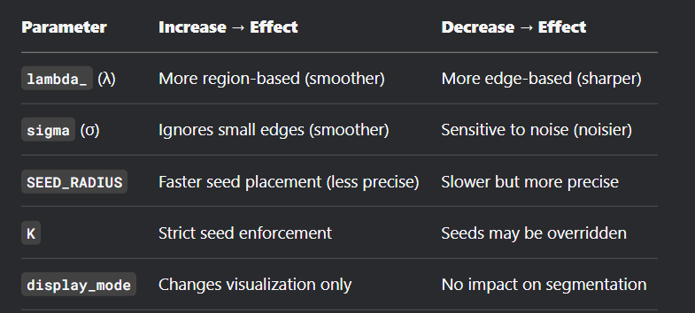

Mathematical Formulation
Segmentation as Energy Minimization We define an energy function:
E(A)=λ⋅R(A)+B(A)
Where:
R(A) – Region term Measures how well each pixel’s intensity fits into object or background models Typically computed using negative log-likelihood from histograms
B(A) – Boundary term enalizes discontinuities between neighboring pixels δ(Ap​,Aq​)=1 if Ap≠Aq​, otherwise 0
λ – Balancing parameter Controls trade-off between region fidelity and boundary smoothness

Slide 8
Graph Construction
Pixels → Nodes: Each image pixel becomes a node in the graph.
Neighbor Edges (n-links): a)Connect adjacent pixels (e.g., 8-neighborhood in 2D) b)Weighted by boundary term. c)Encourage smoothness: higher cost for splitting similar neighbors
Terminal Edges (t-links): a)Connect pixels to terminals: Source (Object) and Sink (Background) b)Encode regional term (negative log-likelihood from histograms) c) Seeds define hard constraints (infinite weight to enforce label)
Graph Cut Output: A min-cut on this graph yields the optimal segmentation boundary that separates object and background nodes

Slide 9
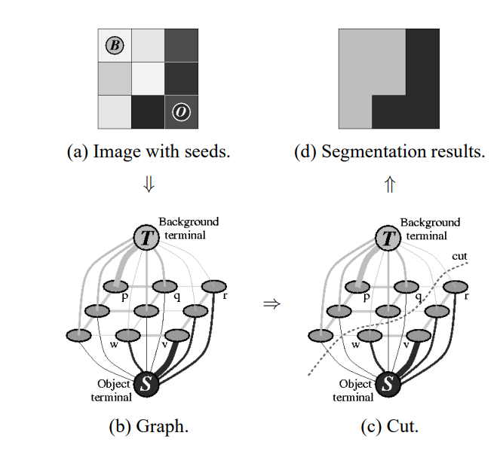

Slide 10
Optimization Strategy
Min-Cut/Max-Flow Optimization:
Find the minimum s–t cut on the graph:
Cut = segmentation boundary
Pixels connected to s → object
Pixels connected to t → background
Boykov-Kolmogorov Algorithm:
Specialized for grid-like graphs in vision
Augmenting path-based max-flow method
Maintains active trees from source/sink
Efficient for 2D/3D image data (~linear time)
Global Optimality Guarantee:
Guarantees globally optimal binary labeling
Works under submodular energy:
Non-negative costs: B_pq ≥ 0, R_p(·) ≥ 0
No local minima
Perfect for user-interactive updates with consistent results

Slide 11
Python Implementation Overview
1. Seed Drawing with OpenCV
Custom UI built using cv2.imshow() and cv2.setMouseCallback()
Left-click and drag to draw seeds
'o' key: object seeds (red)
'b' key: background seeds (blue)
Visual feedback via colored circles on the image
2. Histogram-Based Region Modeling
Convert image to grayscale
Extract pixel intensities at seeded locations
Build 64-bin histograms for object and background based on seeding
Normalize histograms and compute:
3. Graph Construction with PyMaxflow
Use maxflow.Graph[float] to build pixel-level graph
Add:
T-links using regional costs and seed constraints
N-links using intensity difference-based boundary term
Call graph.maxflow() to compute segmentation

Slide 12
Interactive Updates
User Interactivity:
Users can dynamically add or remove object/background seeds.
No need to restart the segmentation from scratch.
Seeds act as hard constraints on the optimization
Efficient Reuse of Previous Computation:
Boykov-Kolmogorov algorithm supports flow re-use:
Previously computed flows are retained.
Only local graph adjustments are needed near updated seeds.
Drastically reduces computational time after seed changes.
No Need to Rebuild Entire Graph:
T-link capacities are updated for affected pixels:
New object seed → increase capacity to source, zero to sink
New background seed → inverse
Graph structure (nodes, n-links) remains unchanged.
Fast incremental re-segmentation in milliseconds for small changes.

Slide 13
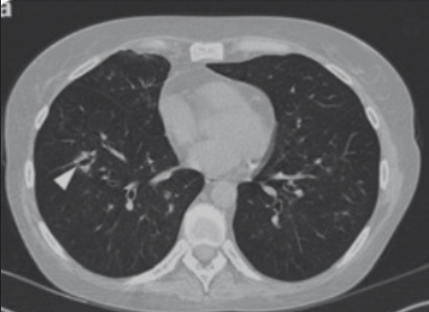
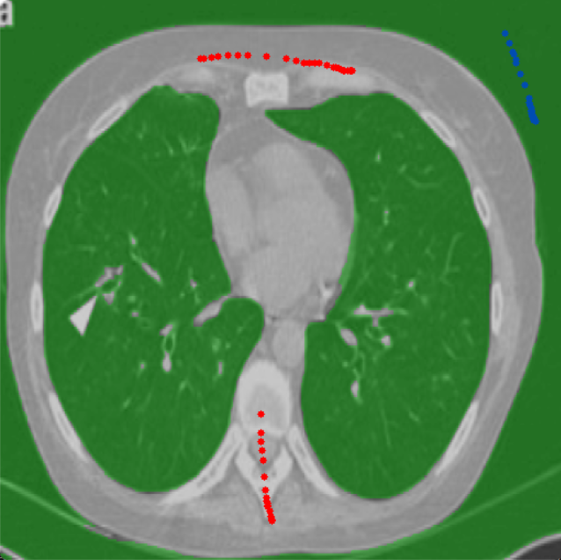
Results Lung.png

Slide 14
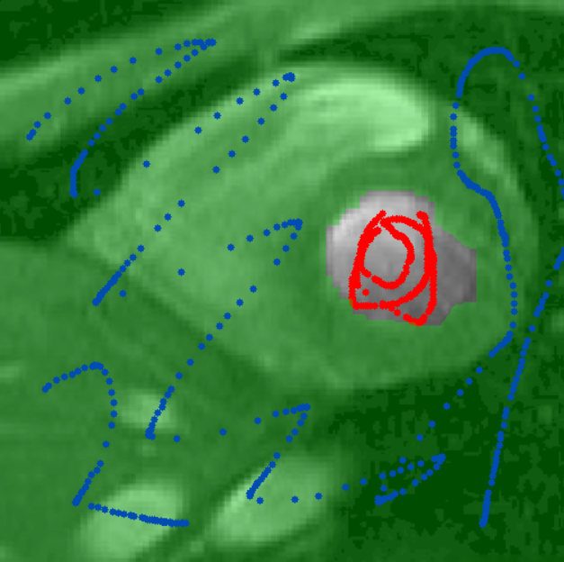
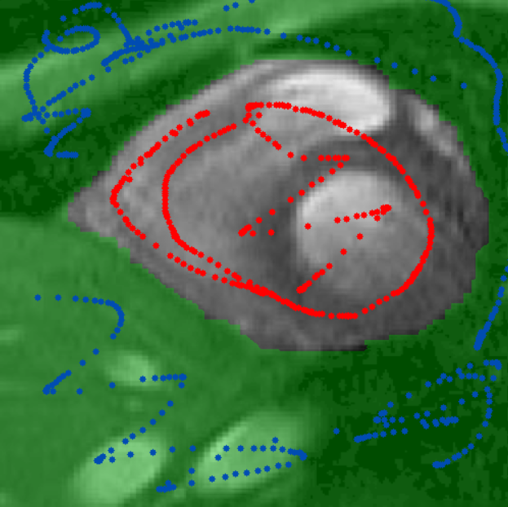
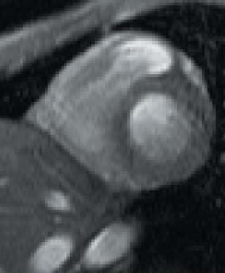
cardiac.png

Slide 15
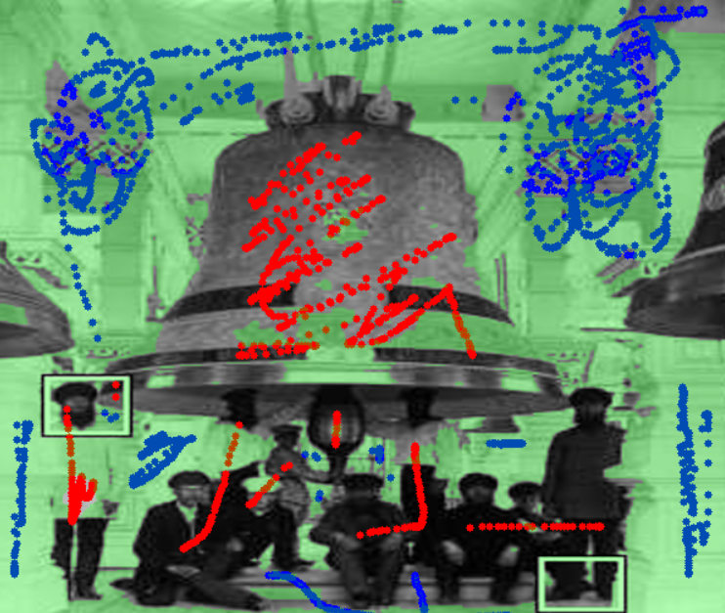
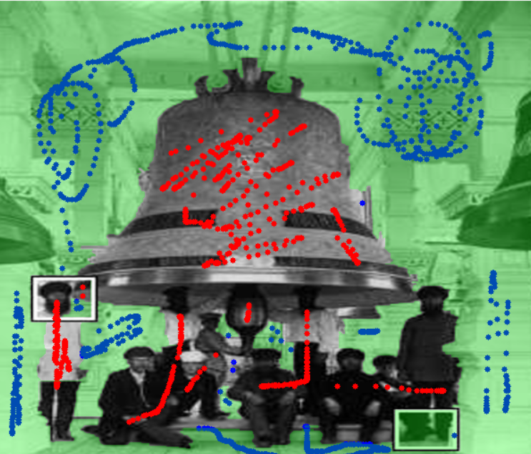
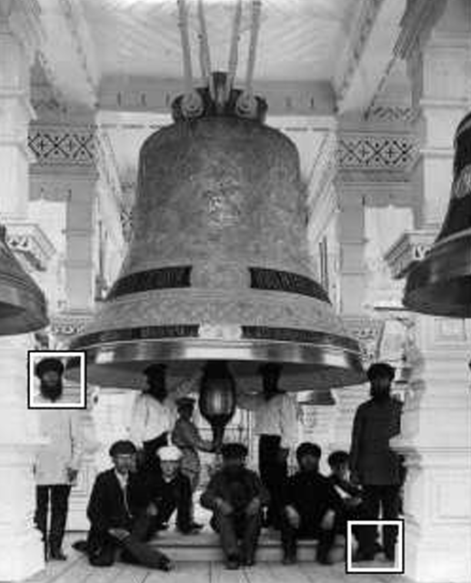
crowd.png
Regional term added
Without regional term
Original

Slide 16

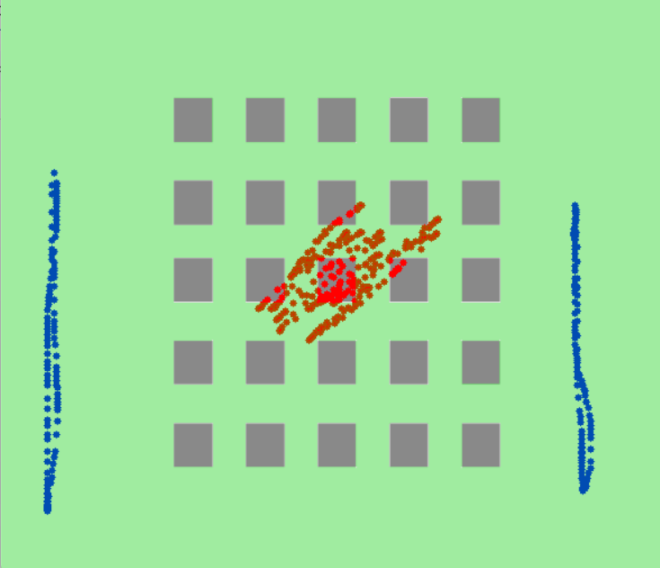
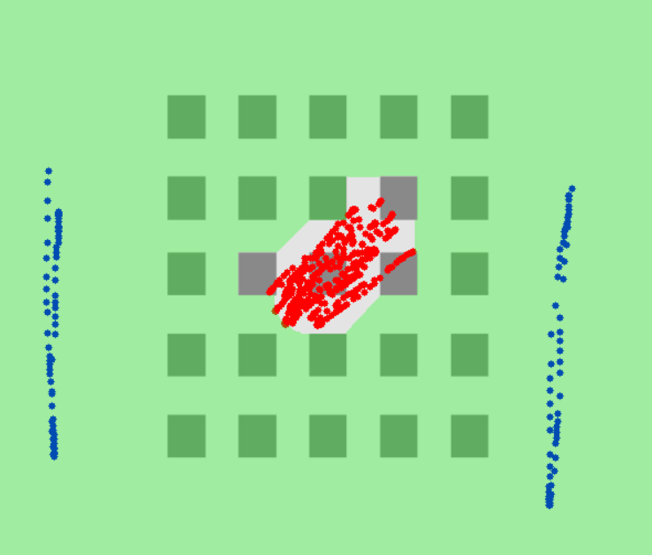
Regional importance box.png
Right lambda=0(no weight age to regionality)
Middle lambda = 10(high)

Slide 17
CONCLUSION
Combines User Input with Optimal Segmentation
Leverages minimal user annotations (seeds)
Uses graph cuts to compute globally optimal binary segmentation
Balances region similarity and boundary strength effectively
Robust and Fast for N-D Data
Applies to 2D images, videos (3D volumes), and medical data
Handles multiple disconnected object regions
Efficient even on large images due to optimized max-flow algorithm
Easy to Interact With and Extend
Intuitive mouse+keyboard UI via OpenCV
Real-time segmentation with visual feedback
Easily extensible for:
Multi-label segmentation
Advanced region modeling (GMMs, deep features)
Semi-automatic seed placement

